Slide 1
Paxos based directory updates for geo-replicated cloud storage
Srivathsava Rangarajan
Advisor: Dr. Sanjay Rao

Slide 2


Geo-Replicated Cloud Storage
Durability
Access Latencies
Typically asynchronous
?!
Notes:
Diff from CDN – stronger consistency requirements in storage.
Examples! Cassandra, Spanner

Slide 3
Classes of Geo-Replicated Cloud Storage
Consistent Hashing based systems | Directory based systems
Compute hash once to store data, recompute hash to find data | Maintain a directory to manage locations of data
No predictability, adaptability in data placement | Flexibility, predictability and adaptability in data placement
Implicitly correct by virtue of properties of hash function | Correctness is not trivial – an important implementation consideration
Example: Cassandra, Dynamo | Example: SPANStore, DTunes, Spanner SPANStore – Zhe Wu et al. DTunes – ISL Spanner – Google
Dir
Dir
Configuration Logic
Dir
?
Dir
?
Dir
Dir
Directory
Family of Hash
Functions
Obj1 | NY,CA
… | …
… | …
H(k)
NY,GA
H(k) + 1
Notes:
While adaptive to workload shifts, the challenge with dir based systems is to maintain all the directories “properly”.

Slide 4
Roadmap
Goals and Contributions
Background
Design and Implementation
Experimental setup and tools
Results
Conclusion

Slide 5
Goals and Contributions
Design and Implementation for updating directories in cloud storage properly
Instrumentation and evaluation of system in emulated WAN setting
Using open source Paxos implementation JPaxos
Tested on public research testbed, PRObE
Open sourced: github.com/Slania/JPaxos-1
Notes:
Focus is on dir updating and not object copying or when to migrate

Slide 6
Roadmap
Goals and Contributions
Background
Design and Implementation
Experimental setup and tools
Results
Conclusion

Slide 7
Single Coordinator Scheme
Why Paxos?
Object | Replica Set
U1 | NY, GA
… | …
Object | Replica Set
U1 | NY, CA
… | …
U1
Single Point of Failure!
U1
Object | Replica Set
U1 | NY, GA
… | …
Object | Replica Set
U1 | NY, CA
… | …
U1
Object Movement
Object | Replica Set
U1 | NY, CA
… | …
Directory Updates

Slide 8
Paxos
A well-known consensus algorithm.
Proposers – They propose values to be chosen
Acceptors – They choose to or not to accept proposed values
Learners – They learn the final, single proposed value that was accepted by the acceptors (just a majority)
Roles to be played
Notes:
Works on concept of a majority of acceptors accepting proposed value

Slide 9
JPaxos
High performance Java implementation
Round robin view-based leader election
Every process plays every role (Proposer, Acceptor, Learner)
Open sourced
Jan Kończak (PUT), Nuno Santos(EPFL), Tomasz Żurkowski(PUT), Paweł T. Wojciechowski(PUT), and André Schiper(EPFL)
Notes:
EPFL, Switzerland
Poznan University of Technology, Poland

Slide 10
DB: PostgreSQL
Open source object-relational database system
Runs on all major OS
Rich query language and high performant query optimizer
Active development for 15 years

Slide 11
Roadmap
Goals and Contributions
Background
Design and Implementation
Experimental setup and tools
Results
Conclusion

Slide 12
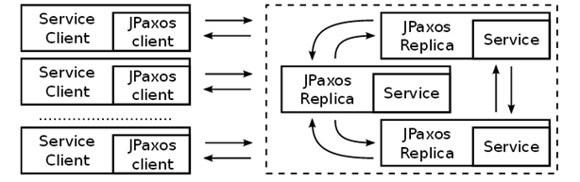
The Players
Directory Client
Directory Client
Directory Client
Directory Service
Mig Init
Protocol
Protocol
Protocol
Migration Agent
Dir
Migration Agent
Dir
Migration Agent
Dir

Slide 13
Directory Service: DB state
Stateless in memory – all state is persisted
Handles API requests for migrations – creates a record for each object migration
ObjId | Old Set | New Set | Dir ACKs | Mig ACKs | Created At | Completed At | Last Updated At | Mig Started At | Migrated? | Completed?
Obj-1 | 1,2 | 1,3 | Dir1,Dir2 | Agt1 | <time> | <time> | <time> | <time> | F | F
Obj-2 | 1,4 | 2 | Dir1,Dir2 | Agt1,Agt2 | <time> | <time> | <time> | <time> | T | T
… | … | … | … | … | … | … | … | … | … | …
Every insert/update operation on these records must be Paxos!
Updated Directories
Completed Migration chunks
When last touched? Avoid starvation.
When was object movement request last (re)initiated?
Is object movement complete?
Is migration request complete?

Slide 14
Directories
Maintain lookup table of mappings between objects and the replica set where they are present
When bootstrapped, they must register through the Directory Client Paxos-ly with contact information
When contacted by Protocol process, synchronously update state and ACK
Idempotent
ID | Host | Port | Timestamp
Serial | IP | Number | Keep-Alive
… | … | … | …
ObjId | Old Set | New Set | Dir ACKs | Mig ACKs | Created At | Completed At | Last Updated At | Mig Started At | Migrated? | Completed?
Obj-1 | 1,2 | 1,3 | Dir1,Dir2 | Agt1 | <time> | <time> | <time> | <time> | F | F
Obj-2 | 1,4 | 2 | Dir1,Dir2 | Agt1,Agt2 | <time> | <time> | <time> | <time> | T | T
… | … | … | … | … | … | … | … | … | … | …

Slide 15
Migration Agents
Blackbox migration process
When bootstrapped, they must register through the Directory Client Paxos-ly with contact information
When contacted by Protocol process, asynchronously perform movement and ACK Paxos-ly
Idempotent
ID | Host | Port | Timestamp
Serial | IP | Number | Keep-Alive
… | … | … | …
ObjId | Old Set | New Set | Dir ACKs | Mig ACKs | Created At | Completed At | Last Updated At | Mig Started At | Migrated? | Completed?
Obj-1 | 1,2 | 1,3 | Dir1,Dir2 | Agt1 | <time> | <time> | <time> | <time> | F | F
Obj-2 | 1,4 | 2 | Dir1,Dir2 | Agt1,Agt2 | <time> | <time> | <time> | <time> | T | T
… | … | … | … | … | … | … | … | … | … | …

Slide 16


Migration Protocol
Stateless, seamless takeover on failure
Co-hosted with every replica (Directory Service)
Directory Service
(Paxos Replica 1)
Directory Service
(Paxos Replica 2)
Directory Service
(Paxos Replica 3)
Protocol 1
Protocol 2
Protocol 3

Slide 17

Migration Protocol: State Machine
Protocol
Directory Client
Directory Service
Directory Client
Directory Client
Directory Service
Directory Service
Protocol
Protocol
Migration Agent
Migration Agent
Migration Agent
Mig Init
Dir
Dir
Dir
Notes:
Set dirty/moved bit on an old replica. Reads served from old, write denied.

Slide 18
Migration Protocol: The DB state
Assume 1 migration agent, 3 directories
ObjId | Old Set | New Set | Dir ACKs | Mig ACKs | Created At | Completed At | Last Updated At | Mig Started At | Migrated? | Completed?
Obj-1 | 1,2 | 1,3 | Null | Null | T1 | Null | T1 | Null | F | F
Obj-1 | 1,2 | 1,3 | Null | Null | T1 | Null | T2 | T2 | F | F
Obj-1 | 1,2 | 1,3 | Null | 1 | T1 | Null | T3 | T2 | F | F
Obj-1 | 1,2 | 1,3 | Null | 1 | T1 | Null | T4 | T2 | T | F
Obj-1 | 1,2 | 1,3 | 1 | 1 | T1 | Null | T5 | T2 | T | F
Obj-1 | 1,2 | 1,3 | 1,2 | 1 | T1 | Null | T6 | T2 | T | F
Obj-1 | 1,2 | 1,3 | 1,2,3 | 1 | T1 | Null | T7 | T2 | T | F
Obj-1 | 1,2 | 1,3 | 1,2,3 | 1 | T1 | T8 | T8 | T2 | T | T

Slide 19
Logging Framework
Directory Service
(Paxos Replica 1)
Directory Service
(Paxos Replica 2)
Non-invasive: Asynchronous, threaded
Aggregated: Centralized, per-request, per-replica
Detailed and Analyzable: 20+ checkpoints, rich query language
Replica
Received
Propose
Accept
Decide
RequestId
1
0ms
10ms
-
20ms
1
2
-
-
15ms
18ms
1
…
…
…
…
…
…

Slide 20
Roadmap
Goals and Contributions
Background
Design and Implementation
Experimental setup and tools
Results
Conclusion

Slide 21
Experimental Testbed: PRObE
Well provisioned (>700 free nodes), public research testbed
NTP synchronized
Infiniband network fabric
NS file based
Possible to snapshot disk images (custom OS + 3rd party modules)
OPS node only node with Internet access, data shuttle point

Slide 22
Experimental Setup and Config
Mig Init
Migration Agent 0
Replica 2
Dir2
Replica 0
Protocol 2
Dir0
Protocol 0
Replica 3
Dir3
Replica 1
Protocol 3
Dir1
Protocol 1
Replica 4
Dir4
Protocol 4
Intra-coast (ms) RTT links
Inter-coast (ms) RTT links
#4 is always leader, all clients forced to connect to #4.
No redirection.

Slide 23
Roadmap
Goals and Contributions
Background
Design and Implementation
Experimental setup and tools
Results
Conclusion

Slide 24
Instrumented Paxos Rounds
Initiation – instantiate new migration
DB create new record
Dir Acks – updating that directory has ACKed new data location
DB update migration record
Update Timestamp – update migration started timestamp
DB update migration record
Mig Agent Acks – migration agent ACK
DB lookup migration agent and update migration record
Migration Complete – set boolean flag to true
DB update migration record

Slide 25

Latency Breakdown
Queuing delay
Paxos client
Link latency
Dir Client
Paxos convergence time
Database access time
Distance from leader to
3rd closest replica (in 5 node cluster)
Composed of:
a) network component
b) queuing delay

Slide 26
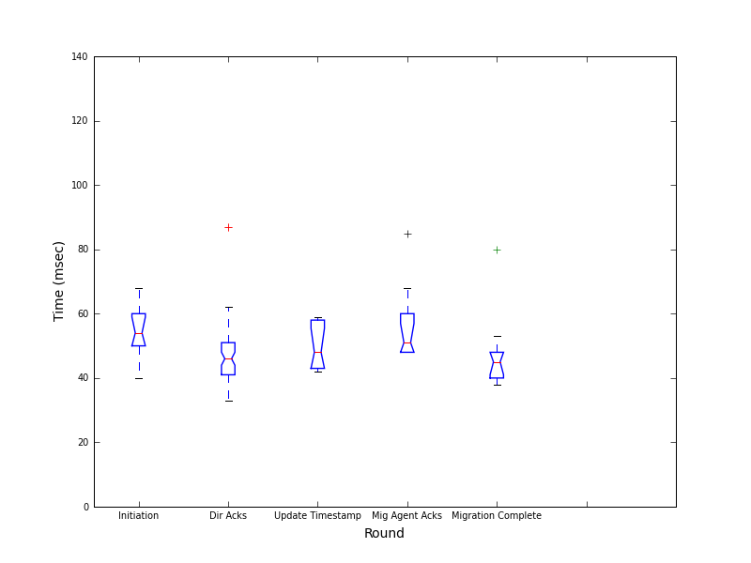
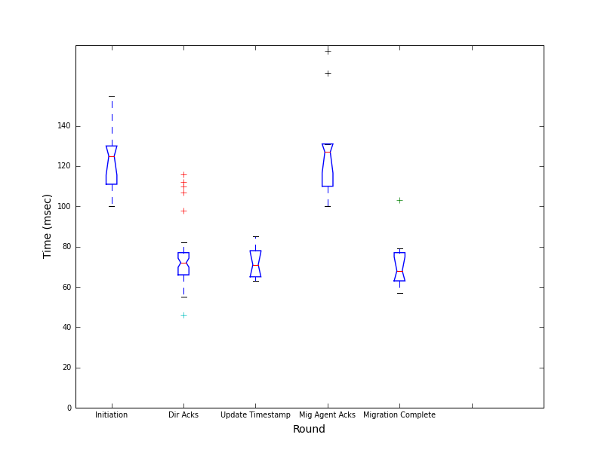
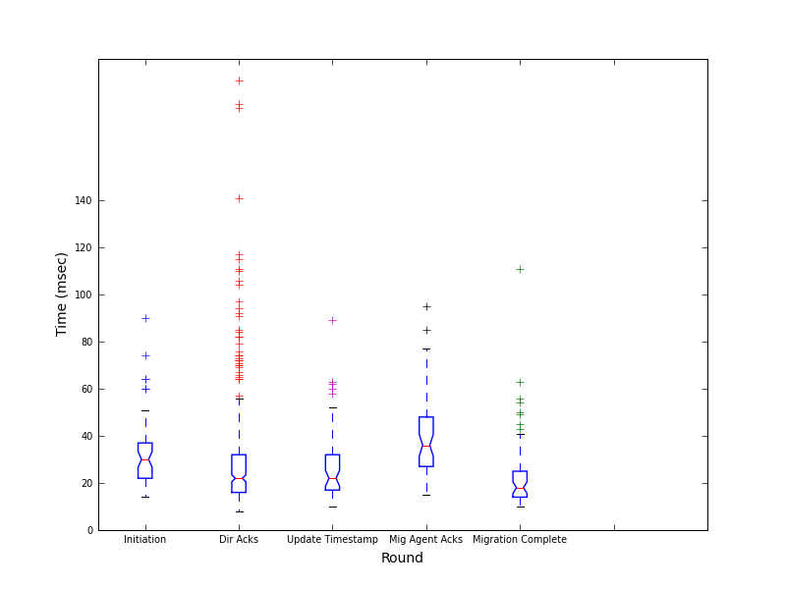
Intercoast – 80ms, Intracoast – 20ms
End to end
Paxos
Database
Notes:
Note:
The split – 70 = 50ish + 20ish.
Note variation in Paxos latencies due to queuing delay
3rd closest replica is East coast distance => Paxos should converge in 20ms (but Dummynet overhead)

Slide 27
Intercoast – 80ms, Intracoast – 20ms
End to end
Link delay
Corresponding DB times
Notes:
Link delay – once again, 20ms dummynet overhead

Slide 28
Intercoast – 80ms, Intracoast – 20ms
Database
Initiation is an insert
Mig Agent Acks involves multiple DB accesses
Notes:
Mention that in the thesis we vary the latency parameters and present other results:
6ms, 60ms
0ms, 60ms
0ms, 0ms
20ms, 60ms
60ms, 120ms
20ms,20ms

Slide 29
Roadmap
Goals and Contributions
Background
Design and Implementation
Experimental setup and tools
Results
Conclusion

Slide 30
Conclusion
The directory update system was successfully implemented
github.com/Slania/JPaxos-1
The latency of operation was found to be reasonable in a WAN setting

Slide 31

Thank you! Questions please?

Slide 32
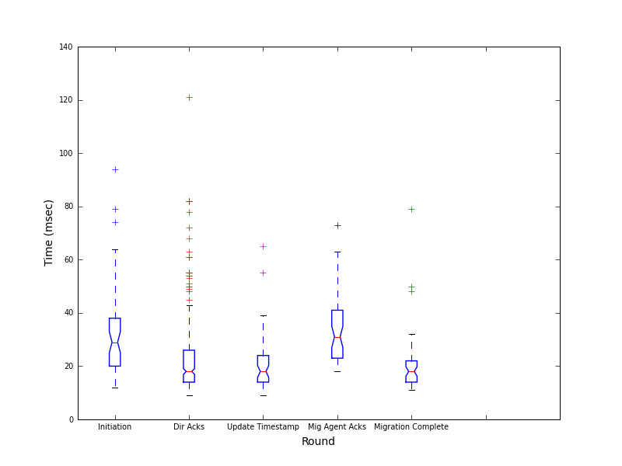
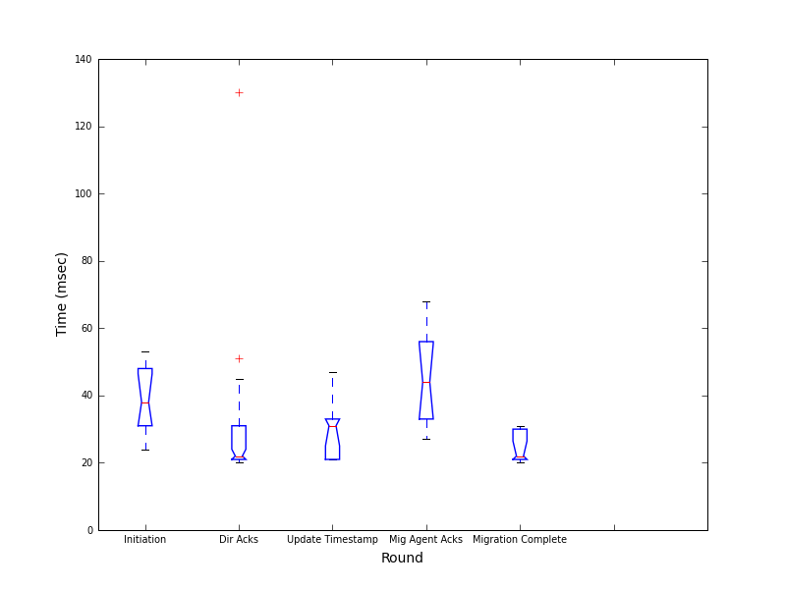
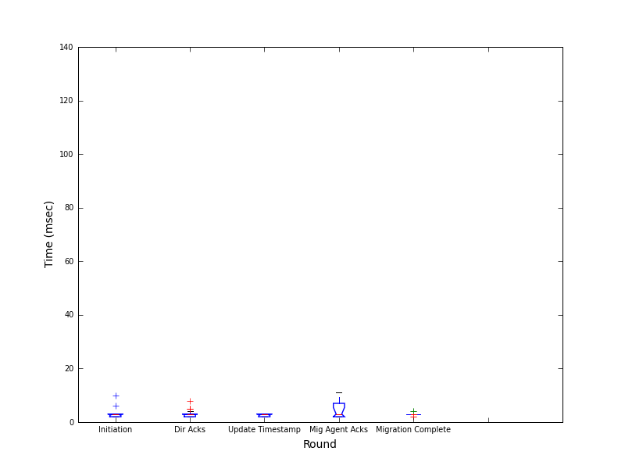
Results: No DummyNet
Directory service time
Client end to end
Server end to end
Notes:
Server end to end latencies from enqueued to decided should be ~1RTT, so only a few milliseconds. (code + queueing)
Client end to end dominated by service time. (state machine code + DB access)
Non-Uniform, why?
Migration Initiator and Migration Agent processes run on different machines from the leader process, and will hence experience link delays.
The Paxos client for the other rounds is the Protocol process which is running co-hosted with the leader replica, and will only experience inter-process communication delay.

Slide 33
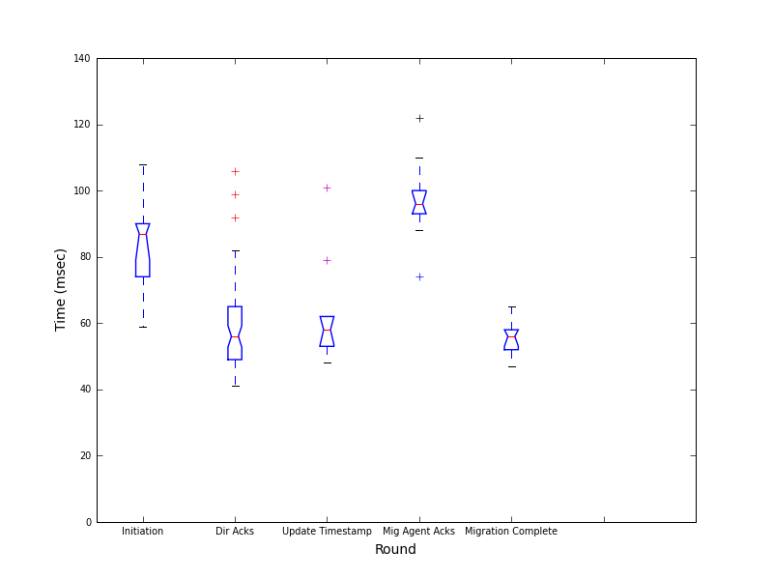
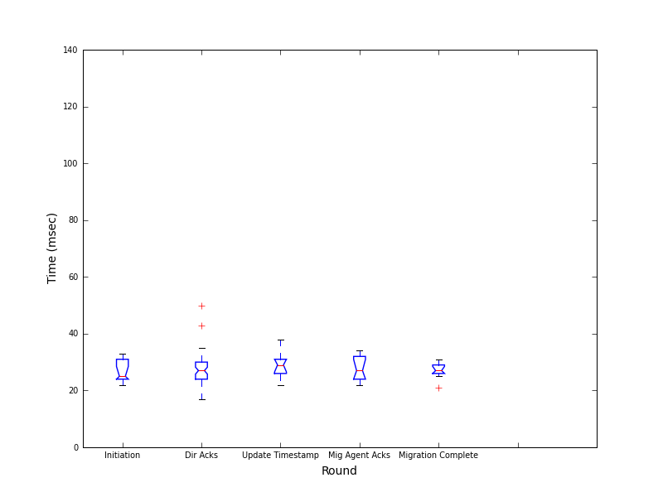
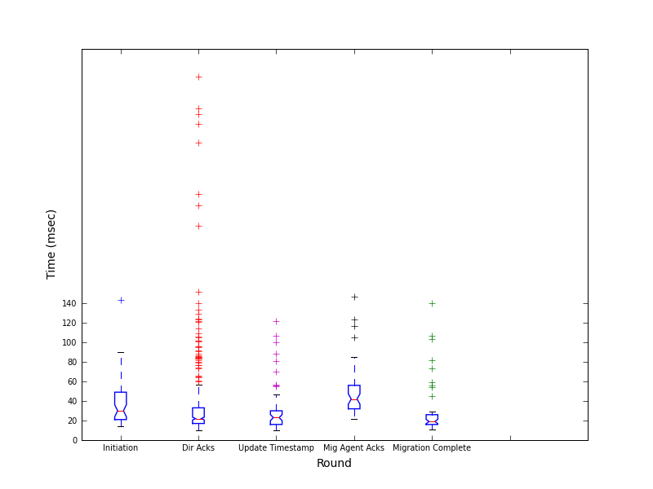
Results: DummyNet with no delay
Client end to end
Server end to end
Directory service time
Notes:
Expected to be very similar to no DummyNet but large deviation!
Attribute deviation to introduction of DummyNet. Flat 20ms increase across the board for some reason.
Apart from that DummyNet is very imprecise at lower delays – 0ms is emulated as 4-6ms.

Slide 34

Single Coordinator Scheme
Paxos: Fault Tolerance through Consensus
Decision Phase
Object Movement
Object | Replica Set
U1 | NY, CA
… | …
Object | Replica Set
U1 | NY, GA
… | …
Directory Updates
U1
Configuration Logic
U1
Decision Phase
Object | Replica Set
U1 | NY, CA
… | …
Object | Replica Set
U1 | NY, GA
… | …
U1
Object Movement
Object | Replica Set
U1 | NY, GA
… | …
Object | Replica Set
U1 | NY, CA
… | …
Decision Phase
Directory Updates
Object Movement
Directory Updates

Slide 35


Geo-Replicated Cloud Storage
Geo-replication offers:
Better access latencies
Redundancy/Disaster recovery
Two classes of such systems
Consistent Hashing based systems | Directory based systems
Compute hash once to store data, recompute hash to find data | Maintain a directory to manage locations of data
Very limited flexibility in data placement and replication factor | Maximum flexibility in data placement and replication factor
Implicitly correct by virtue of properties of hash function | Correctness is not trivial – an important implementation consideration

Slide 36
What do we need?
Consistent, flexible data placement and migration on demand.
Consistent: Where exactly is the data now, will it get where it needs to be?
Flexible: Can the data be placed in any chosen replica subset of the geo-replicated cloud at a per-object level?
Migration: Can I repeatedly update this data configuration at runtime?

Slide 37


Faulty Directories
While data consistencies can be flexible, meta-data needs to be strictly correct.
That is, not only can we not have contradictions, but we also require completeness - if one directory knows, every other directory is also expected to know.
Replica2
Object-1
Replica1
Object-1 | Replica 1
Object-1?
Dir1
Client
Replica-1!
Object-1 | Replica 2
Object-1 | Replica 1
Object-1?
Replica-2!
Dir2

Slide 38

Heterogeneous, adaptive replication
Distributed, wide area directory
Flexible, re-configurable replication policies
Algorithms for monitoring workload changes
Replica Placement Engine
Distributed Application
Consistency parameters
Logs/metrics data
Node-1
Object config
Geo-replicated data-store
i | N | r | w | loc
Wide area Meta-data Directory
Node-2
obj | old | new | ACK | …
1 | 1,2 | 2,3 | 2 | …
2 | 1,5 | 4 | 4 | …
Object locs?
obj | old | new | ACK | …
1 | 1,2 | 2,3 | 2 | …
2 | 1,5 | 4 | 4 | …

Slide 39
Directory Service: Recovery
JPaxos on crash recovery replays all requests from a checkpoint.
Must precisely replay requests from last unplayed request.
Save last executed request number in a single atomic transaction with the last executed request.
Request ID
Request
Played?
Request 1
INSERT
x,y
Yes
Request 2
UPDATE
x,z
Yes
…
…
Yes
Monotonically True
Request 49
UPDATE
x,a
Yes
Request 50
ADD
x,b
Yes
Request 51
ADD
x,c
No

Slide 40
Directory Service: Snapshotting + Restoration
For log truncation, on demand snapshots of the database must be made.
Dump DB, serve dumpfile as snapshot. Delete DB and restore completely from dumpfile.
Log file
DB
Request ID | Request
1 | INSERT x,10
2 | UPDATE x,20
3 | READ x
4 | INSERT y,4
5 | UPDATE y,y+4
… | …
x | y
10 | -
20 | -
20 | -
20 | 4
20 | 8
… | …
equivalent

Slide 41
Paxos
Phase1:
Proposer picks globally exclusive proposal number ‘n’ and sends a ‘Prepare’ request to a majority set of acceptors.
An acceptor responds to a ‘Prepare’ if ‘n’ is greater than greatest accepted so far and responds with accepted value if any.
Phase 2:
If proposer receives responses from majority of Acceptors, it sends an ‘Accept’ request with either value of greatest numbered value Accepted or value of its own choosing.
If an acceptor receives an ‘Accept’ request for proposal ‘n’ >= highest ‘Prepare’ request it has responded to, it accepts the proposal.

Slide 42
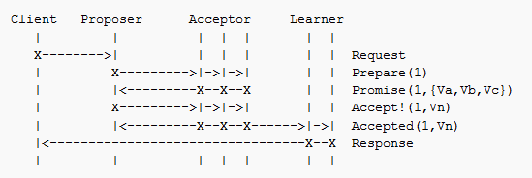
Paxos
Proposer first elicits permission to propose by sending ‘Prepare’ to Acceptors and waiting for majority.
Acceptors respond with highest accepted values and corresponding proposal numbers if any. ({a,Va},{b,Vb},{c,Vc})
Proposer picks Vn for Accept | n greatest.
Acceptors accept Vn and inform Learners.

Slide 43
Paxos
A consensus algorithm. How do we get multiple processes to agree upon a single value?
Roles to be played
Proposers – They propose values to be chosen
Acceptors – They choose to or not to accept proposed values
Learners – They learn the final, single proposed value that was accepted by the acceptors (not all, just a majority, see below)
Safety Requirements:
Only a single value proposed may be chosen
Processes learn about value iff they are chosen

Slide 44






Paxos
Proposer
Acceptors
Learners
Prepare #1?
{null}
{null}
{null}
Yes, {}!
Yes, {}!
Yes, {}!
Time
{1}
{1}
{1}
Propose {1,a}!
{1,a}
{1,a}
{1,a}
Accept{1,a}!
Accept{1,a}!
Accept{1,a}!
Notes:
Phase1:
Proposer picks globally exclusive proposal number ‘n’ and sends a ‘Prepare’ request to a majority set of acceptors.
An acceptor responds to a ‘Prepare’ if ‘n’ is greater than greatest accepted so far and responds with accepted value if any.
Phase 2:
If proposer receives responses from majority of Acceptors, it sends an ‘Accept’ request with either value of greatest numbered value Accepted or value of its own choosing.
If an acceptor receives an ‘Accept’ request for proposal ‘n’ >= highest ‘Prepare’ request it has responded to, it accepts the proposal.

Slide 45


JPaxos: Everyone is everything!
Propose {1,a}!
Accept {1}!
Accept {1}!
Accept {1}!

Slide 46
ER diagram?

Slide 47
Idempotency and leader change

Slide 48
Paxos dueling proposers

Slide 49
Graphs – individual, large

Slide 50
Backup

